Slide 1
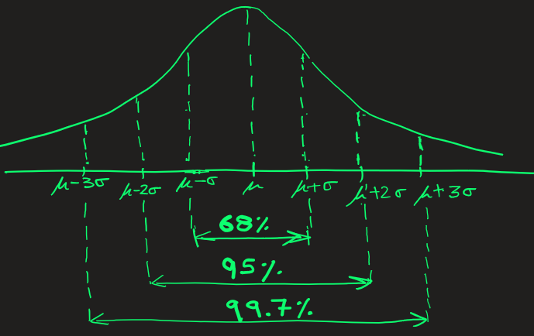
Empirical Rule: 68 – 95 – 99.7
Empirical Rule describes how data is distributed in a normal distribution AKA Gaussian distribution — bell-shaped curve.
This is the rule devised by nature which is almost universally true.

Slide 2
Empirical Rule: 68 – 95 – 99.7
About 68% of data lies within 1 standard deviation (σ) of the mean (μ). → Between μ − σ and μ + σ.
About 95% of data lies within 2 standard deviations of the mean. → Between μ − 2σ and μ + 2σ.
About 99.7% of data lies within 3 standard deviations of the mean. → Between μ − 3σ and μ + 3σ.

Slide 3
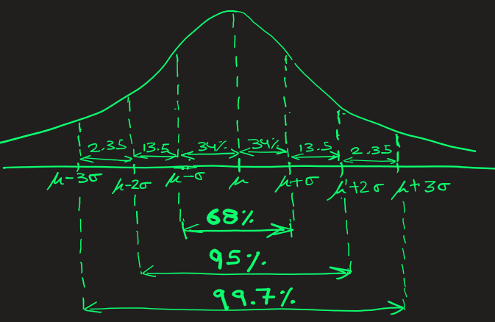
68 – 95 – 99.7
The curve is symmetrical: The left side is mirroring right.
What does this symmetry mean?
The implication:
68/2 = 34% of data lies in between μ − σ and μ
68/2 = 34% of data lies in between μ and μ + σ
(95 – 68)/2 = 13.5% of data lies in between μ − 2σ and μ − σ
(95 – 68)/2 = 13.5% of data lies in between μ + σ and μ + 2σ
And so on…..

Slide 4
68 – 95 – 99.7
EXAMPLE: Let’s say exam scores of students from all schools are normally distributed with mean (μ) = 70 and standard deviation (σ) = 10.
It essentially means that
68% of students scored between μ − σ and μ + σ
-> 68% of students scored between 60 and 80
95% of students scored between μ − 2σ and μ + 2σ
-> 95% of students scored between 50 and 90
99.7% of students scored between μ − 3σ and μ + 3σ
-> 99.7% of students scored between 40 and 100

Slide 5
68 – 95 – 99.7
PROBLEM: Suppose the heights of adult men in a city are normally distributed with
mean (μ) = 175 cm and standard deviation (σ) = 5 cm.
1) Using empirical rule determine the range around mean that includes 68% of men height
2) Using empirical rule determine the range around mean that includes 95% of men height
Answer:
1)
68% of men's height is in between μ − σ and μ + σ
68% of men's height is in between 170 and 180 cm
2)
95% of men's height is in between μ − 2σ and μ + 2σ
95% of men's height is in between 165 and 185 cm

Slide 6
68 – 95 – 99.7
PROBLEM: Suppose the heights of adult men in a city are normally distributed with
mean (μ) = 175 cm and standard deviation (σ) = 5 cm.
1) Using empirical rule determine the percentage of people whose height is between 175 and 180 cm
2) Using empirical rule determine the percentage of people whose height is between 170 and 185 cm
Answer:
1)
175 cm to 180 cm :
By looking at graph , 68 / 2 = 34%
2)
170 cm to 185 cm :
By looking at graph , 68% + 13.5% = 81.5%

